Slide 1



Possibilities for the integration of ISO 10012 in an accredited laboratory
36th International Scientific Symposium
Metrology and Metrology Assurance 2026
Part of Science Days of TU-Sofia
September 7-11, 2026
Sozopol, Bulgaria
Tzvetelin Gueorguiev and Tsanko Karadzhov
2026-09-10

Slide 2
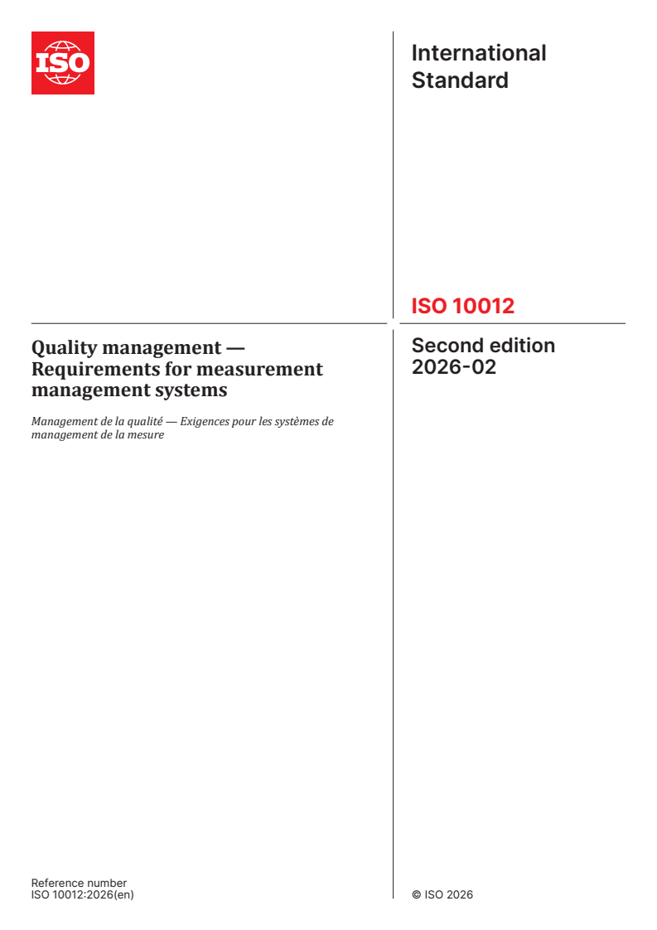
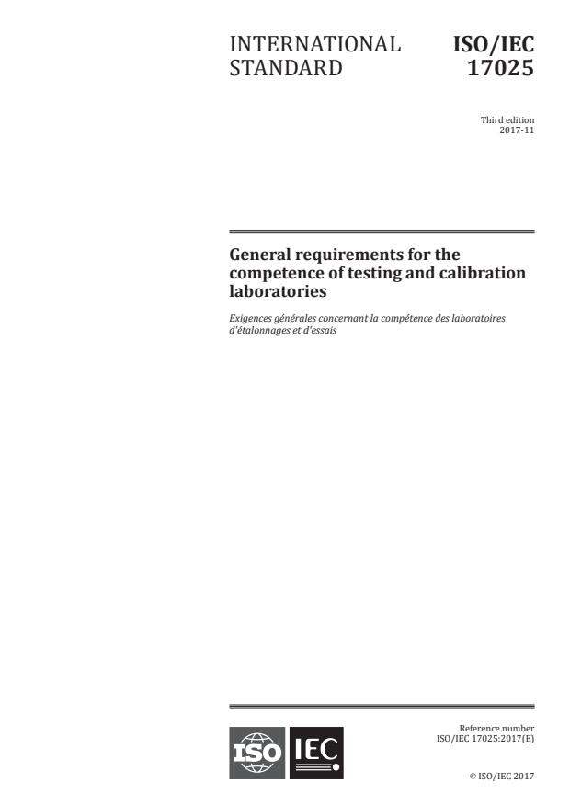
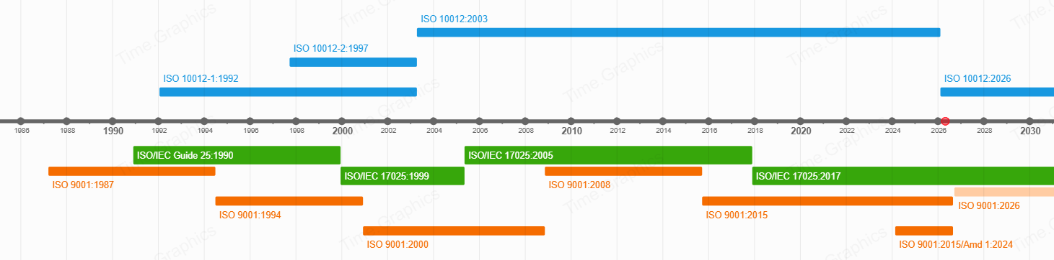
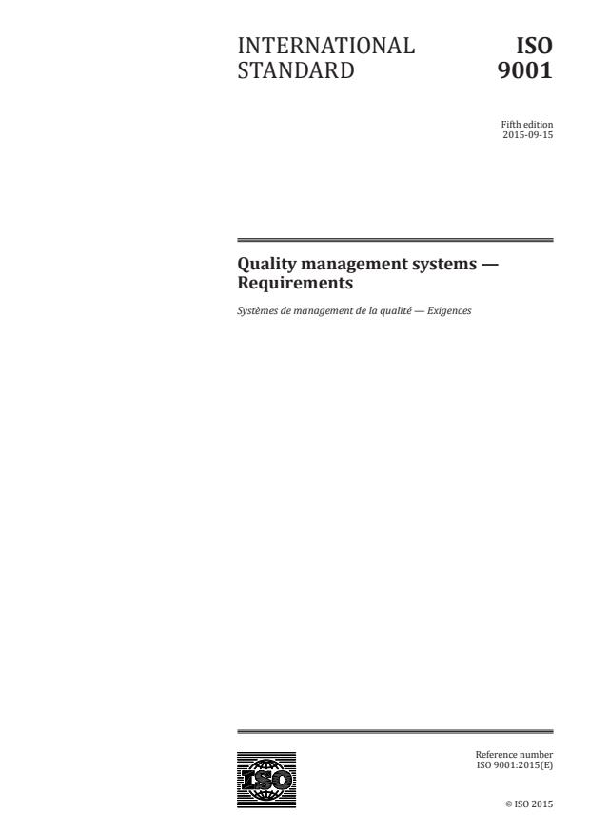
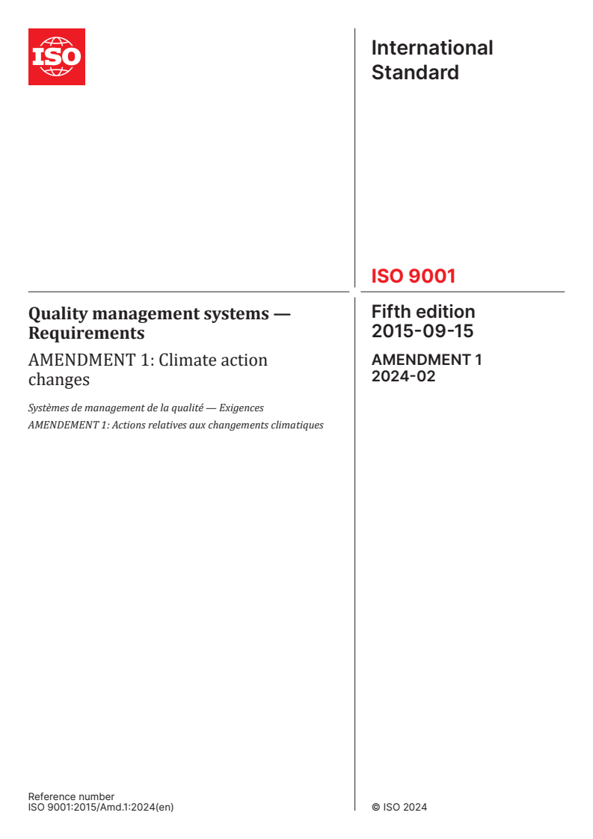
Introduction

Slide 3
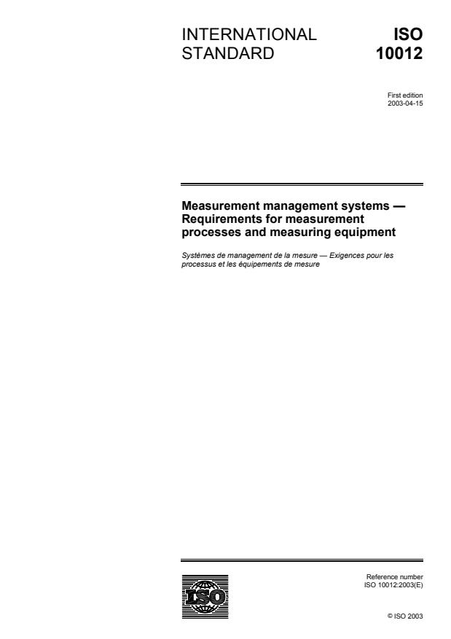
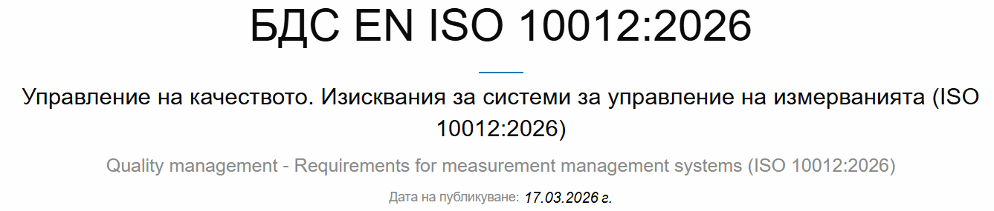
ISO 10012:2003
Measurement management systems — Requirements for measurement processes and measuring equipment
(2023-04-14)
ISO 10012:2026
Quality management — Requirements for measurement management systems
(2026-02-12)

Slide 4
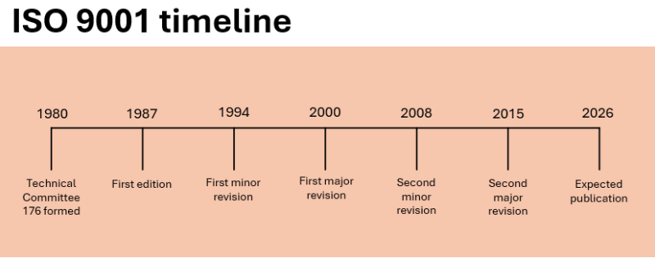
2026-09-16

Slide 5
ISO/IEC 17025:2017
General requirements for the competence of testing and calibration laboratories
(2017-11-29)

Slide 6
Introduction
This paper also does not present a mix of requirements of ISO 10012, ISO 9001, and ISO/IEC 17025.
In contrast, it suggests elements of ISO 10012 that can improve existing ISO/IEC 17025-based management systems in accredited laboratories for testing and calibration.

Slide 7
Discussion
A. A clause-by-clause comparison between ISO 10012:2003 and ISO 10012:2026
B. Structural comparison between the current editions of ISO 10012, ISO 9001, and ISO/IEC 17025

Slide 8
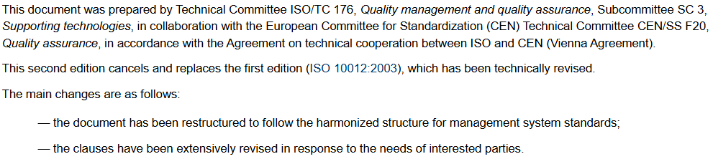
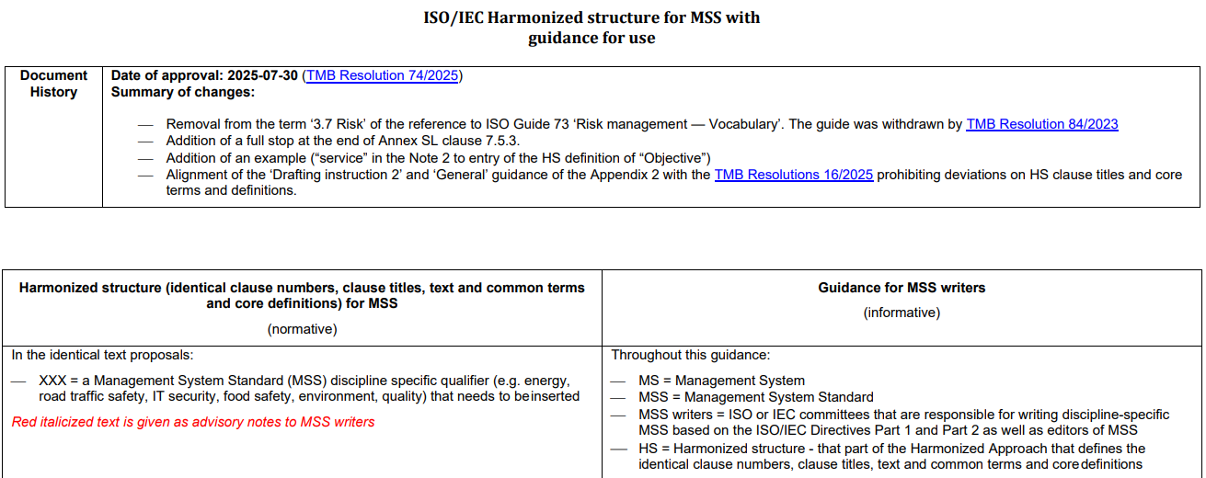
Discussion –
ISO 10012:2003 vs. ISO 10012:2026
https://www.iso.org/obp/ui/en#iso:std:iso:10012:ed-2:v1:en
Annex SL - Harmonized text with guidance for MSS writers (2026-07-01)

Slide 9
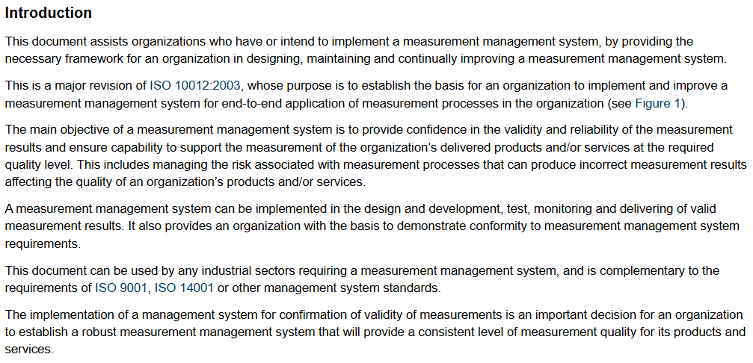
Discussion –
ISO 10012:2003 vs. ISO 10012:2026
https://www.iso.org/obp/ui/en#iso:std:iso:10012:ed-2:v1:en

Slide 10
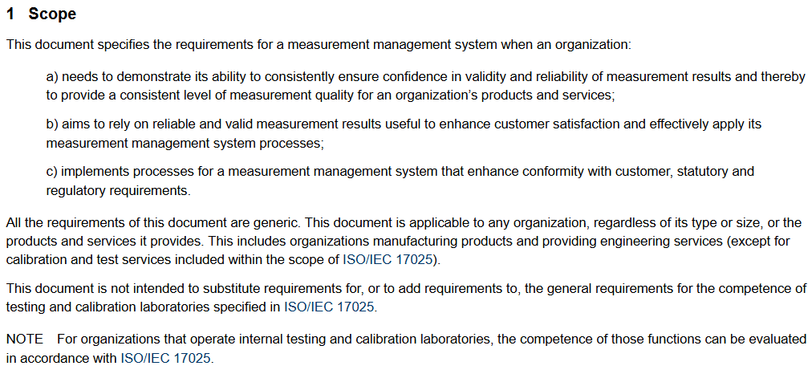
Discussion –
ISO 10012:2003 vs. ISO 10012:2026
https://www.iso.org/obp/ui/en#iso:std:iso:10012:ed-2:v1:en

Slide 11
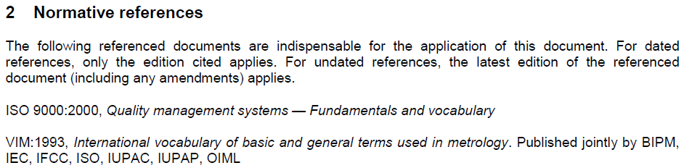
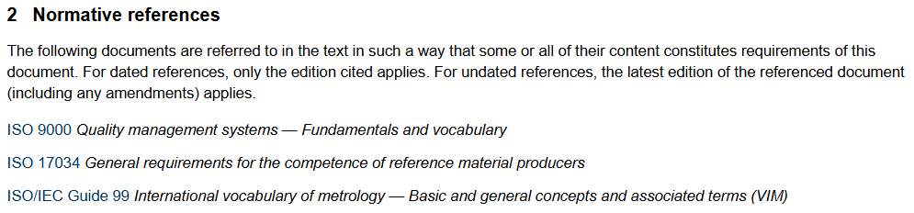
Discussion –
ISO 10012:2003 vs. ISO 10012:2026
https://www.iso.org/obp/ui/en#iso:std:iso:10012:ed-2:v1:en

Slide 12
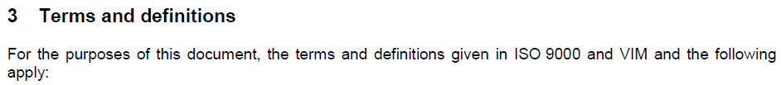
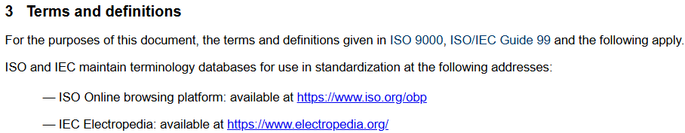
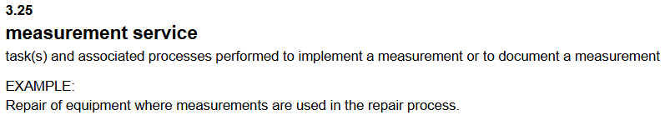
Discussion –
ISO 10012:2003 vs. ISO 10012:2026
https://www.iso.org/obp/ui/en#iso:std:iso:10012:ed-2:v1:en

Slide 13
Discussion –
ISO 10012:2003 vs. ISO 10012:2026
ISO 10012 clause number and title
ISO 10012:2003 | ISO 10012:2026
4 General requirements | 4 Context of the organization
5 Management responsibility | 5 Leadership
5.1 Metrological function | 5.3 Roles, responsibilities and authorities
5.2 Customer focus | 5.4 Customer focus
5.3 Quality objectives | 6.2 Measurement management objectives and planning to achieve them
5.4 Management review | 9.3 Management review

Slide 14
Discussion –
ISO 10012:2003 vs. ISO 10012:2026
ISO 10012 clause number and title
ISO 10012:2003 | ISO 10012:2026
6 Resource management | 7 Support
6.1 Human resources 6.1.1 Responsibilities of personnel 6.1.2 Competence and training | 7.1.2 People 5.3 Roles, responsibilities and authorities 7.2 Competence
6.2 Information resources 6.2.1 Procedures 6.2.2 Software 6.2.3 Records 6.2.4 Identification | 7.5 Documented information
6.3 Material resources 6.3.1 Measuring equipment 6.3.2 Environment | 7.1.3 Facilities and environmental conditions
6.4 Outside suppliers | 8.4 Control of externally provided measurement processes, products and services

Slide 15
Discussion –
ISO 10012:2003 vs. ISO 10012:2026
ISO 10012 clause number and title
ISO 10012:2003 | ISO 10012:2026
7 Metrological confirmation and realization of measurement processes | 8 Operation
7.1 Metrological confirmation 7.1.1 General 7.1.2 Intervals between metrological confirmation 7.1.3 Equipment adjustment control 7.1.4 Records of the metrological confirmation process | Annex A (informative) Calibration intervals optimization
7.2 Measurement process 7.2.1 General 7.2.2 Measurement process design 7.2.3 Realization of the measurement process 7.2.4 Records of measurement processes | 8.2 Requirements for measurement processes 8.1 Operational planning and control 8.3 Design and development of measurement processes 8.5 Measurement process implementation 7.5 Documented information
7.3 Measurement uncertainty and traceability 7.3.1 Measurement uncertainty 7.3.2 Traceability | 8.3.5.3 Measurement uncertainty Annex B Measurement uncertainty 8.3.5.4 Metrological traceability

Slide 16
Discussion –
ISO 10012:2003 vs. ISO 10012:2026
ISO 10012 clause number and title
ISO 10012:2003 | ISO 10012:2026
8 Measurement management system analysis and improvement | 9.1.3 Analysis and evaluation
8.1 General | 9.1 Monitoring, measurement, analysis, and evaluation 10 Improvement
8.2 Auditing and monitoring 8.2.1 General 8.2.2 Customer satisfaction 8.2.3 Measurement management system audit 8.2.4 Monitoring of the measurement management system | 9 Performance evaluation 9.1.1 General 9.1.2 Customer satisfaction 9.2 Internal audit 9.1 Monitoring, measurement, analysis, and evaluation

Slide 17
Discussion –
ISO 10012:2003 vs. ISO 10012:2026
ISO 10012 clause number and title
ISO 10012:2003 | ISO 10012:2026
8 Measurement management system analysis and improvement | 9.1.3 Analysis and evaluation
8.3 Control of nonconformities 8.3.1 Nonconforming measurement management systems 8.3.2 Nonconforming measurement processes 8.3.3 Nonconforming measuring equipment | 8.7 Control of nonconforming outputs 8.7.1 Handling of nonconforming outputs 8.7.2 Documented information
8.4 Improvement 8.4.1 General 8.4.2 Corrective action 8.4.3 Preventive action | 10 Improvement 10.1.1 Measurement management system improvement 10.1.2 Measurement process improvement 10.2 Nonconformity and corrective action 6.1 Actions to address risks and opportunities Annex C Measurement decision risk and rules

Slide 18
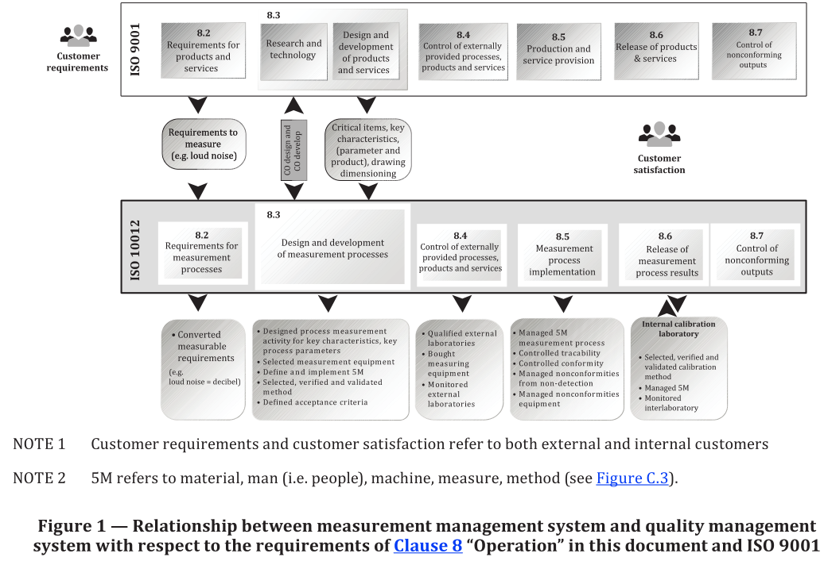
Discussion –
ISO 10012, ISO 9001, and ISO/IEC 17025

Slide 19
Discussion –
ISO 10012, ISO 9001, and ISO/IEC 17025
ISO/IEC 17025:2017 Clause 4 “General requirements”, including its two subclauses 4.1 “Impartiality” and 4.2 “Confidentiality”, has no direct connection to any of the elements of ISO 10012:2026.

Slide 20
Discussion –
ISO 10012, ISO 9001, and ISO/IEC 17025
ISO/IEC 17025:2017 Clause 5 “Structural requirements” refers to several ISO 10012:2026 clauses:
4.2 “Understanding the needs and expectations of interested parties”;
4.3 “Determining the scope of the measurement management system”;
4.4 “Measurement management system”;
5.3 “Roles, responsibilities and authorities”;
7.1.2 “People”
7.1.3 “Facilities and environmental conditions”;
7.4 “Communication”;
7.5 “Documented information”;
8.2 “Requirements for measurement processes”;
8.4 “Control of externally provided measurement processes, products and services”.

Slide 21
Discussion –
ISO 10012, ISO 9001, and ISO/IEC 17025
ISO/IEC 17025:2017 Clause 6 “Resource requirements” has the following elements that also relate to ISO 10012:2026 clauses:
6.1 “General”, which resembles 7.1 “Resources” in ISO 10012:2026;
6.2 “Personnel”: mainly related to 7.1.2 “People”, but also refers to requirements in 5.3 “Roles, responsibilities and authorities”, 7.2 “Competence”, 7.4 “Communication”, and 7.5 “Documented information”;
6.3 “Facilities and environmental conditions” is very similar to 7.1.3 “Facilities and environmental conditions” in ISO 10012:2026;
6.4 “Equipment”: subclause 7.1.4 “Equipment” in ISO 10012:2026 has a substantially smaller number of requirements and is less demanding than its counterpart in ISO/IEC 17025:2017;
6.5 “Metrological traceability” is referenced in subclause 8.3.5.4 “Metrological traceability” in ISO 10012:2026;
6.6 “Externally provided products and services” is closely related to 8.4 “Control of externally provided measurement processes, products and services” in ISO 10012:2026, but its content is much richer.

Slide 22
Discussion –
ISO 10012, ISO 9001, and ISO/IEC 17025
ISO/IEC 17025:2017 Clause 7 “Process requirements” unites 11 subclauses directly related to the measurement processes in accredited laboratories. These processes and their relationships to ISO 10012:2026 clauses are:
7.1 “Review of requests, tenders and contracts”: related to 8.2.4 “Review of customer requirements for measurement processes”, which is part of 8.2 “Requirements for measurement processes”;
7.2 “Selection, verification and validation of methods”: subclauses 8.3.4 “Design and development controls” and 8.5.1 “Control of measurement processes”;
7.3 “Sampling”: item 8.5.1.1 c) 6) “the use of statistical sampling in a measurement process for product or service acceptance”. Statistical sampling plans by variables can be established based on the ISO 3951 series of standards, and for sampling by attributes, the ISO 2859 series;
7.4 “Handling of test or calibration items”: discussed in 8.3.4 “Design and development controls”;
7.5 “Technical records” can be considered as 7.5 “Documented information”;
7.6 “Evaluation of measurement uncertainty”: more detailed requirements and guidance are presented in 8.3.5.3 “Measurement uncertainty”;

Slide 23
Discussion –
ISO 10012, ISO 9001, and ISO/IEC 17025
7.7 “Ensuring the validity of results”: the validity of measurement results is mentioned on several occasions in ISO 10012:2026: 5.4 “Customer focus”, 6.1 “Actions to address risks and opportunities”, 7.1.3 “Facilities and environmental conditions”, 7.3 “Awareness”, 7.5 “Documented information”, 8.3 “Design and development of measurement processes”, 8.5.2 “Identification and traceability”, 8.6.2 “Documented information relating to release of results”, and in Annex A “Calibration intervals optimization”;
7.8 “Reporting of results” is referred to in 7.5 “Documented information” and 8.5.5 “Measurement process post-delivery activities”;
7.9 “Complaints”: can be associated mainly with 9.1.2 “Customer satisfaction”, but also 7.5 “Documented information” and 10.2 “Nonconformity and corrective action”;
7.10 “Nonconforming work” can be supported by two clauses in ISO 10012:2026, namely 8.7 “Control of nonconforming outputs” and 10.2 “Nonconformity and corrective action”;
7.11 “Control of data and information management”: mainly related to 7.5 “Documented information”, but also mentioned in clauses 8.1 “Operational planning and control”, 8.3 “Design and development of measurement processes”, 8.4 “Control of externally provided measurement processes, products and services” and 8.5 “Measurement process implementation”.

Slide 24
Discussion –
ISO 10012, ISO 9001, and ISO/IEC 17025
ISO/IEC 17025:2017 Clause 8 “Management system requirements” and its subclause 8.1 “Options” have a direct linkage to ISO 10012:2026 and its subclause 4.4 “Measurement management system”. “Option A” (item 8.1.2) defines the minimum requirements for a laboratory management system. These are explained in more detail in subclauses 8.2 to 8.9. “Option B” (item 8.1.3) is relevant for laboratories that have already implemented an ISO 9001-based quality management system.
The following Table compares ISO/TS 17025:2017 clauses to ISO 10012:2026 clauses and can be considered an analogy to subclause 8.1.3 “Option B” in ISO/IEC 17025:2017 that links ISO 9001 requirements and specifies additional requirements for the management system of an accredited laboratory.

Slide 25
Discussion –
ISO 10012, ISO 9001, and ISO/IEC 17025
ISO/IEC 17025:2017 | ISO 10012:2026
8.2 Management system documentation (Option A) | 7.5 Documented information
8.3 Control of management system documents (Option A)
8.4 Control of records (Option A)
8.5 Actions to address risks and opportunities (Option A) | 6.1 Actions to address risks and opportunities
8.6 Improvement (Option A) | 10 Improvement
8.7 Corrective actions (Option A) | 10.2 Nonconformity and corrective action
8.8 Internal audits (Option A) | 9.2 Internal audit
8.9 Management reviews (Option A) | 9.3 Management review

Slide 26
Potential benefits of using ISO 10012 in ISO/IEC 17025 accredited laboratories
The Laboratory Complex for Measurement, Testing and Calibration (LCMTC) at the Technical University of Gabrovo is accredited for conformance to the ISO/IEC 17025:2017 requirements.
Integrating elements of ISO 10012:2026 that are not explicitly related to the requirements of ISO/IEC 17025:2017:
7.1.5 “Organizational knowledge”, and possibly the standard ISO 30401 “Knowledge management systems — Requirements”;
7.3 “Awareness” along with ISO 10018 “Quality management — Guidance for people engagement”;
8.1.2 “Operational risk management” and the guidelines of ISO 31000;
10.1 “Continual improvement” and using the requirements and guidance of the ISO 56000 series of standards for innovation management systems.

Slide 27
Conclusions
This paper has presented a “clause-by-clause” comparison of the main changes from the 2003 edition of ISO 10012 that are introduced with its latest release in 2026.
A benefit for laboratory quality managers is the comparison between the clauses ISO 10012, ISO 9001, and ISO/IEC 17025. This comparison has revealed clauses in ISO 10012 that are not explicitly part of ISO/IEC 17025.
Along with other international standards, they can be used for enhancing existing management systems of accredited laboratories.

Slide 28

Acknowledgement
This research was funded by the European Regional Development Fund within the OP “Research, Innovation and Digitalization Programme for Intelligent Transformation 2021-2027”, Project No. BG16RFPR002-1.014-0006 National Center of Excellence Mechatronics and Clean Technologies.

Slide 29



Thank you for your attention!
Assoc. Prof. Tzvetelin Gueorguiev, PhD
tz.georgiev@tugab.bg
Assoc. Prof. Tsanko Karadzhov, PhD
karadjov@tugab.bg

